Slide 1

Cab Industry Analysis
Internship work 1
19-May-2024

Slide 2
Agenda
Background
Data Preprocessing
EDA
Recommendations

Slide 3
Background – Cab Industry Analysis
XYZ is a private equity firm in US. Due to remarkable growth in the Cab Industry in last few years and multiple key players in the market, it is planning for an investment in Cab industry.
Objective : Do exploratory data analysis and provide actionable insights to help XYZ firm understand the cab industry, assisting decision – making of choose more appropriate company to make investment.
The analysis has been divided into three parts:
Data Preprocessing
Data Preprocessing and visualization
Recommendations for investment

Slide 4
Data Preprocessing
21 Features ( including 7 derived features)
Timeframe of the data: 2016-01-01 to 2018-12-31
(find full data in year 2016 from external source)
Total data points :359,392
Assumptions:
There are outliers are present in Price_Charged predictor, but due to
unavailability of trip duration details ,we are not treating this as outlier.
We uses Price_Charged and Cost_of_Trip features used to calculate profit each trip. And we divide the price and cost by KM_travelled to get cost and price per KM
Users feature of city dataset is treated as total number of cab users in the city.
we have assumed that this can be other cab users that do not choose Pink Cab
or Yellow Cab.
Cab_Data.csv
Customer_ID.csv
Transaction_ID.csv
City.csv
Full cab data

Slide 5
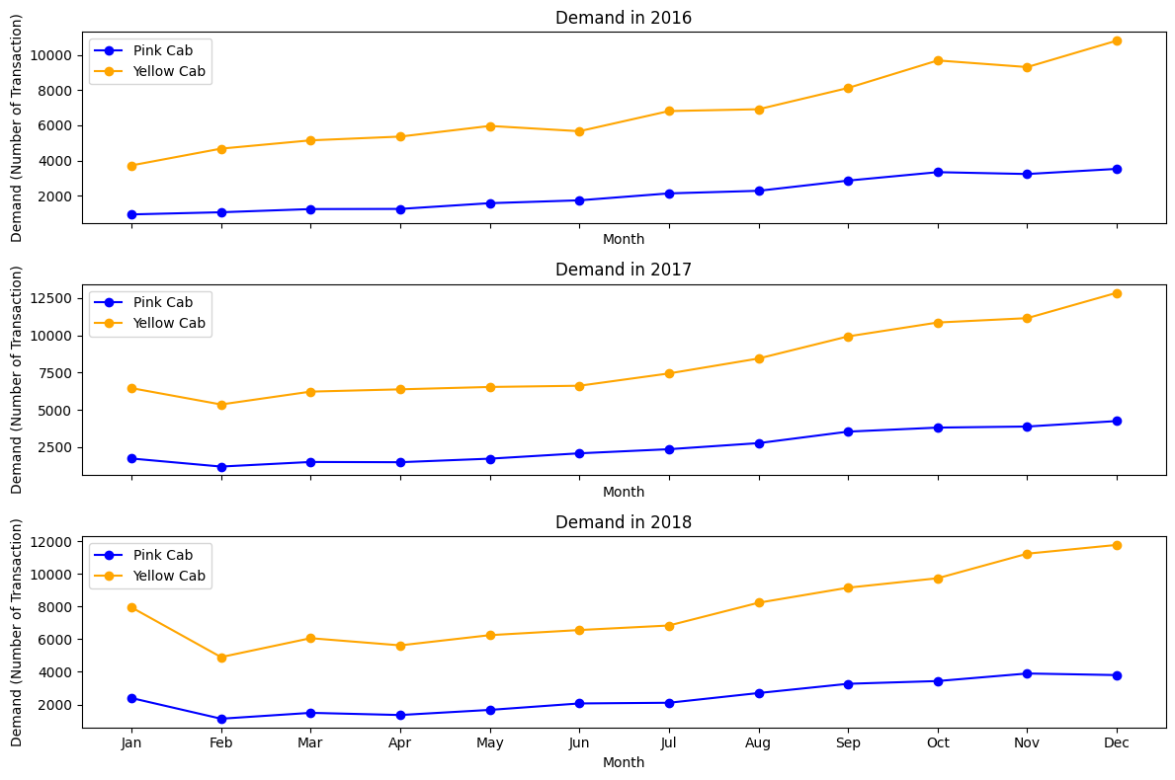
Is There Seasonality Appeared in Demand?
The demand (number of transactions) of both cab companies has an upward trend within a year.
Demand peaks at the end of the year and falls back at the first few months of the year.

Slide 6
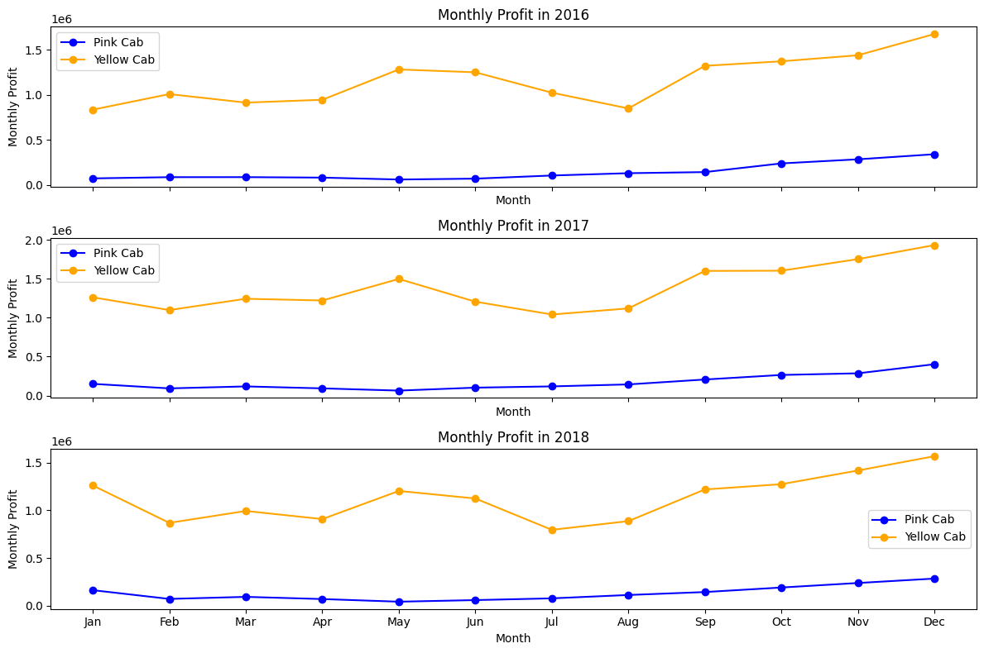
Is There Seasonality Appeared in Profit?
There is a quarterly trend of profit in both companies.
Demand will increase in second and fourth quarter, but decreased in first and third quarter.

Slide 7
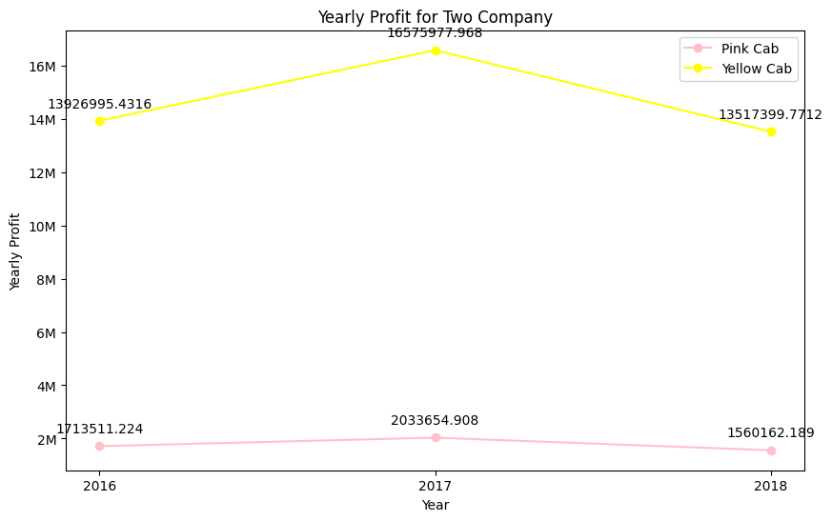
Profit Analysis
The yearly profit of both companies increases in 2017 but decreases in 2018.
Profit of Yellow Cab is significantly larger than profit of Pink Cab, it is almost 7 times of Pink Cab.

Slide 8
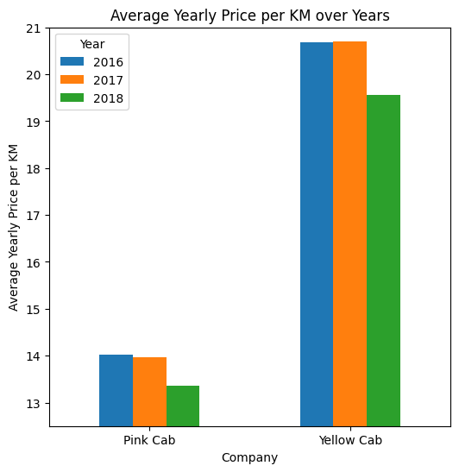
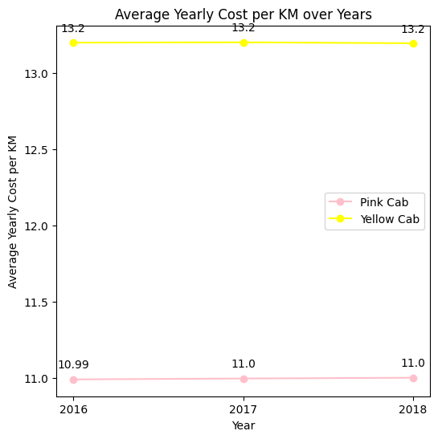
Is There Seasonality Appeared in Profit?
The cost per kilometer remains unchanged from 2916-2018, but the price charged per kilometer decreases, especially in year 2018.
It may explain why the yearly profit of both companies in year 2018 decreases.

Slide 9
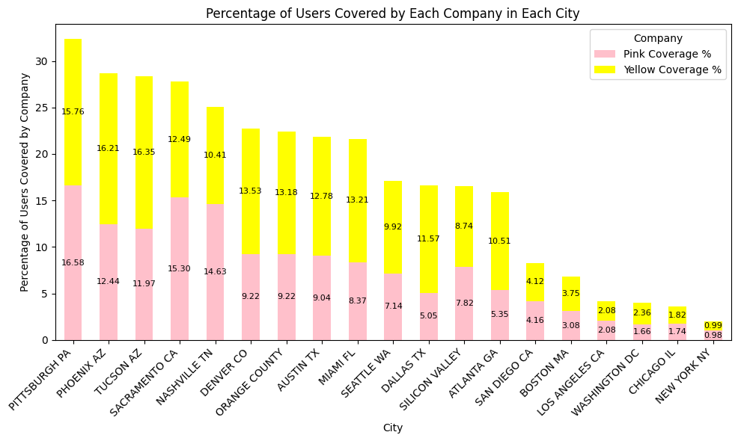
How Many Cab Users in Different Cities are Covered by Each Company (in Percentage %) ?
Yellow Cab has higher user coverage in 16 cities than Pink Cab.
Pink cab has higher user coverage in Pittsburgh PA, Sacramento CA, and Nashville TN.

Slide 10
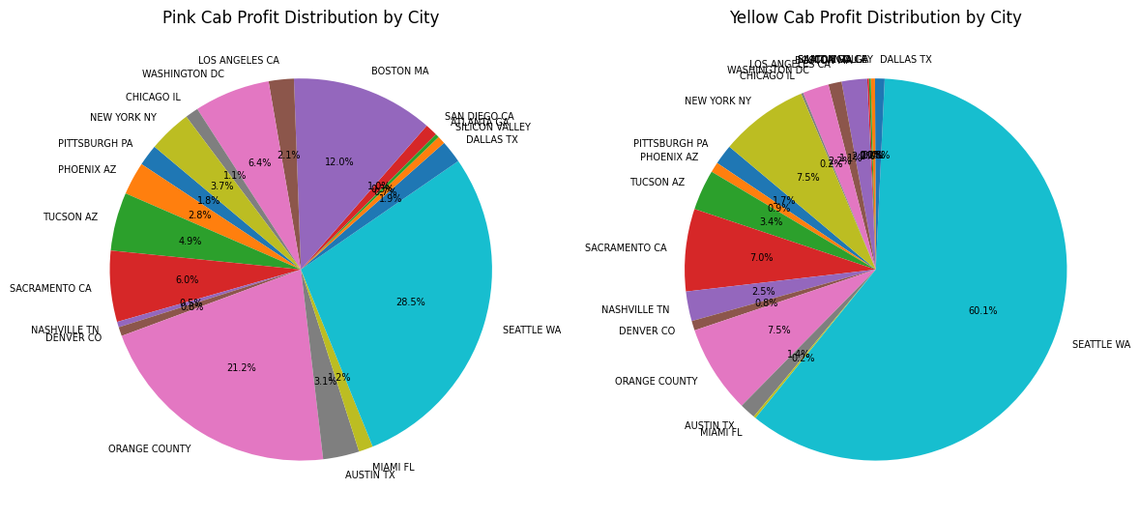
Cities Contribution to Yearly Profit of Each Company
The top 4 profit contribution cities for Pink Cab is Seattle WA, Orange County, Boston MA, and Washington DC.
The top 4 profit contribution cities for Yellow Cab is Seattle WA, Orange County, New York NY, and Sacramento CA. Notably, more than half of yearly profit in Yellow Cab is from Seattle WA.

Slide 11
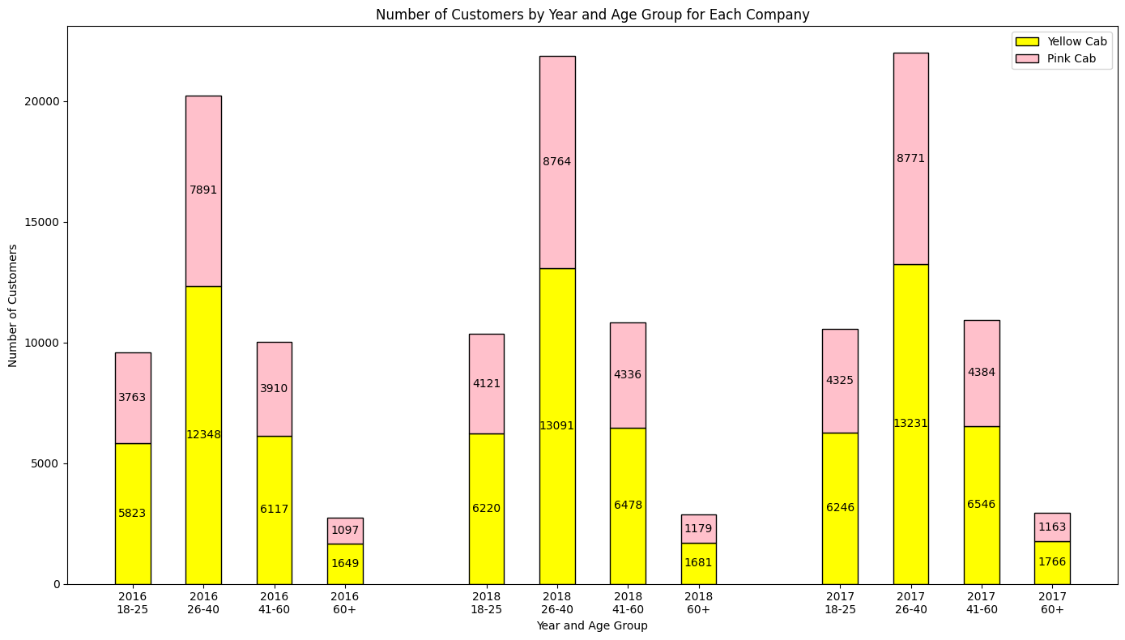
For each age group, what cab company they choose?
The Age of customers are divided in four groups: 18-25, 26-40, 41-60, and 60 +.
Yellow Cab are more popular in all age groups than Pink Cab.

Slide 12
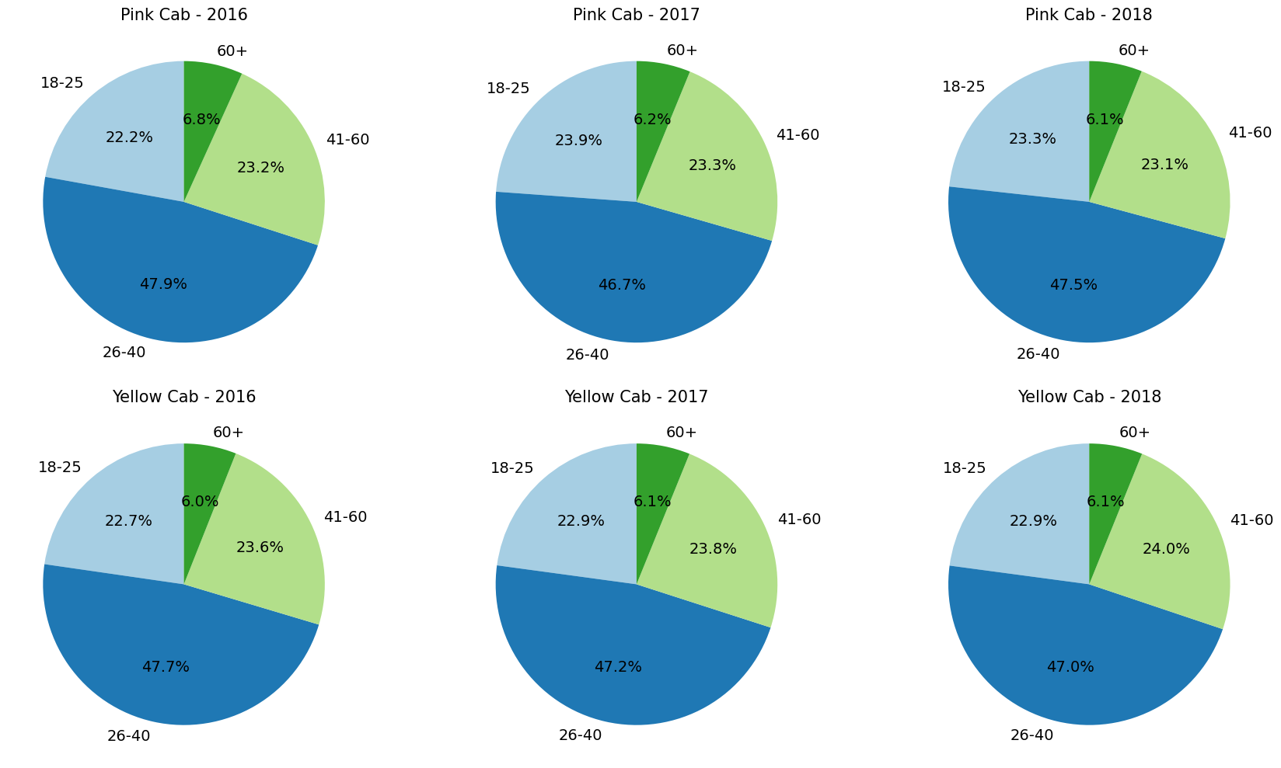
Profit Contribution of Each Age Group to Each Company in 3 Years?
The profit contribution distribution of all age groups is similar in both companies.
Pink Cab has less profit from 60 + aged customers and more profit from 26-40 aged customers over years.
Yellow Cab has lower profit from 26-40 aged customers and more profit from other age groups over years.

Slide 13
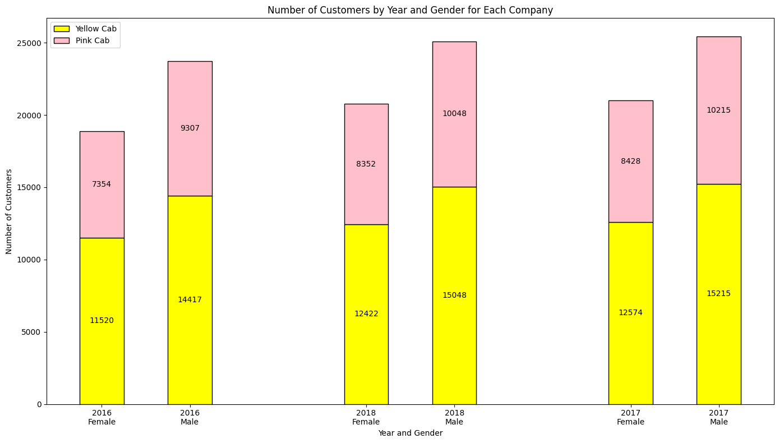
For Each Gender, What Cab Company They Choose?
Yellow Cab are more popular in both gender than Pink Cab.
Since both companies acquired more users over years, their total number of customers is increasing.

Slide 14
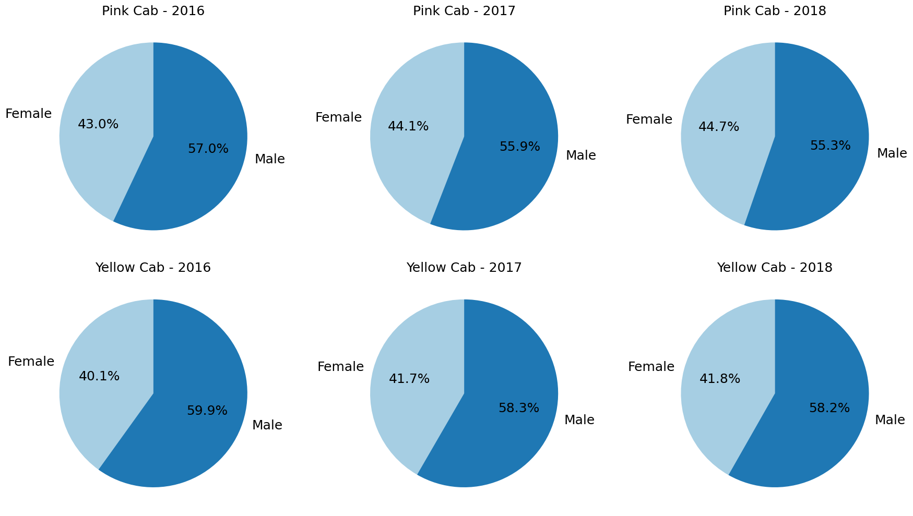
Profit Contribution of Different Gender to Each Company in 3 Years?
The profit contribution distribution of two genders is similar in both companies.
Pink Cab and Yellow Cab all have less profit from male customers and more profit from female customers over years.

Slide 15
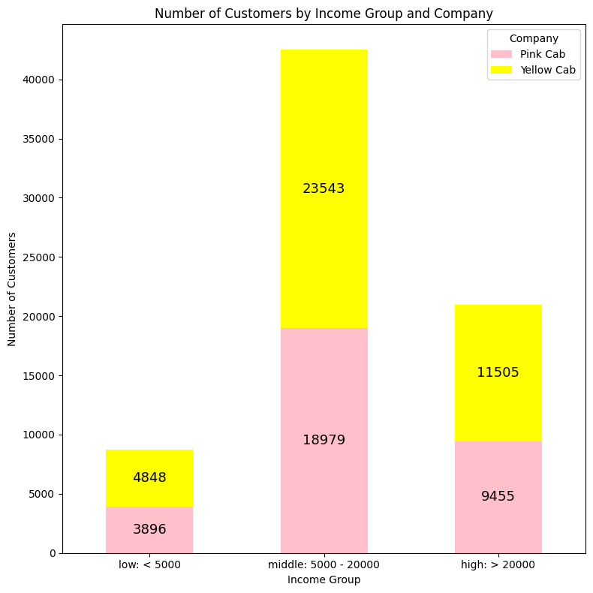
For Different Income Groups, What Cab Company They Choose?
Income Groups | Pink Cab | Yellow Cab
Low | 44.56% | 55.44%
Middle | 44.63% | 55.37%
High | 45.11% | 54.89%
Most customer in both companies are from middle income group (5000 – 20000).
Yellow Cab is popular in all income groups.

Slide 16
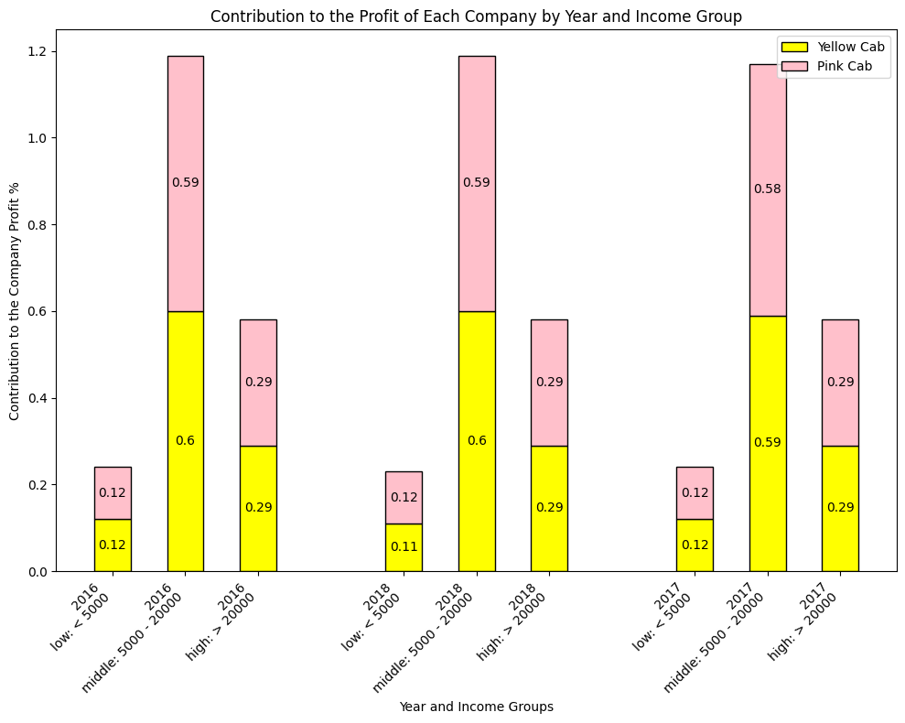
Profit Contribution of Each Income Group to Each Company in 3 Years?
The profit contribution of different income groups has similar pattern in three years.
More than half of yearly profit in both companies are from middle income group (5000 – 20000).

Slide 17
Investment Recommendation
We evaluated both companies from different perspective, here are the key insights:
Seasonality of demand and profit: There are seasonality appeared in both demand and profit. Demand increases and reach peak at the end of the year. Profit increased in second and fourth quarter.
Profit analysis: The yearly profit of Yellow Cab is about 7 times of yearly profit of Pink Cab
Price Charged vs. Cost per KM: The price charged per KM remains unchanged but the cost per PM increases, which lead to drop in yearly profit in 2018.
Customer Reach in different cities & profit contribution: Both companies has higher user coverage in Pittsburgh. Seattle contributes most to the yearly profit of both companies.
Age wise customer reach & profit contribution: Most customers in both companies are in 26-40 age groups, and they are the main contributor to the profit. Yellow Cab is more popular in all age groups.
Gender wise analysis: There are more male customers than female customers. Yellow Cab is more popular in both gender.
Income wise customer reach & profit contribution: Most customers in both companies are from middle income group (5000 - 20000), and they are the main contributor to the profit. Yellow Cab is more popular in all income groups.
From our finding, we recommend XYZ firm to invest in Yellow Cab. And there are more potential users in the market, we expect a profit to grow as we acquire more customers.

Slide 18
Thank You

